Slide 1
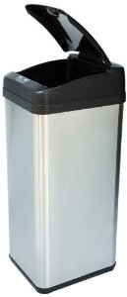
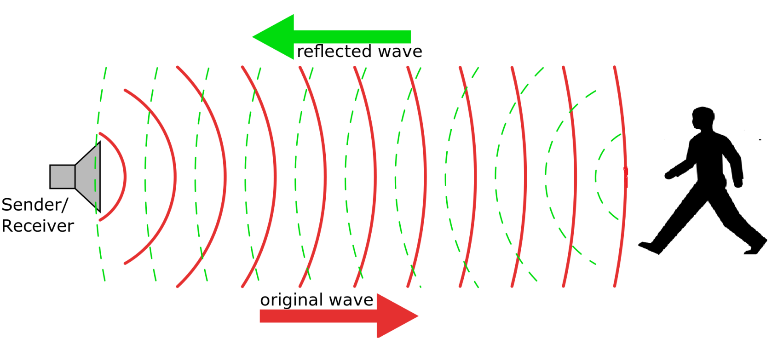
Solution
A feature of our trash can is an ultrasonic sensor to detect if anybody is trying to approach to throw away trash so it can activate.

Slide 2
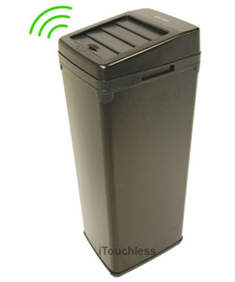
Solution
Once the ultrasonic sensor is activated the trash can will say “I only take recyclables items like cardboard, plastic bottles, and paper.

Slide 3
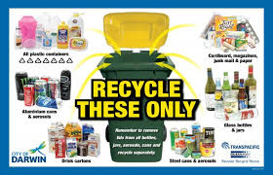
Solution
There is also a sign for people with hearing problems that has pictures of recyclable examples

Slide 4
Solution
What all this is ,is trying to change people behaver so people will form a habit for appropriate recycling. This habit helps the earth and ourselves. we should treat it as important as eating.

